Slide 1
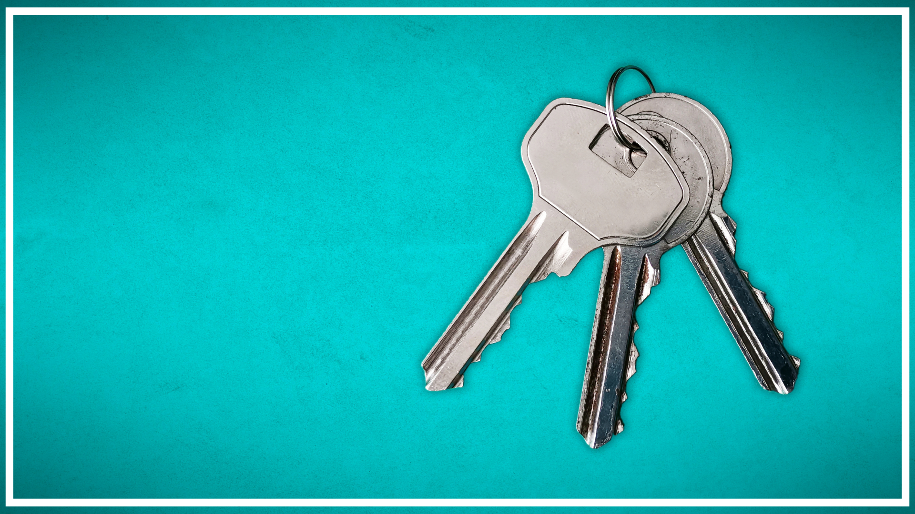
Seller Funded
Buydowns
Win-Win for Both Buyers & Sellers

Slide 2
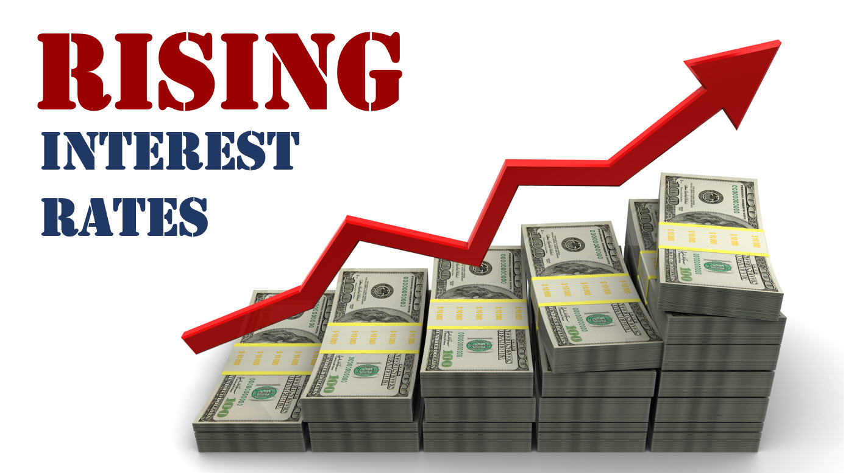

Slide 3
As Interest Rates Rise, Seller Buydowns Are Making a Big Comeback

Slide 4
Your Presenter

Slide 5
What is an Interest Rate Buydown?

Slide 6
Interest Rate
Buydown
Paying Money to the Lender to Buy an Interest Rate Lower
=

Slide 7
There are 2 Types of Interest Rate Buydowns

Slide 8
1
2
Permanent Rate Buydown
TEMPORARY Rate Buydown

Slide 9
Permanent Rate Buydown
Paying Discount Points to Permanently Buydown the Interest Rate

Slide 10
What are Discount Points?

Slide 11
%
Discount Points are Fees Paid to Lower the Interest Rate for the Life of the Loan Term.
Discount Points are a Percentage (%) of the Loan Amount

Slide 12
Example Permanent Buydown
Purchase Price - $400,000
Down Payment - $40,000 (10%)
Loan Amount - $360,000
Par Rate – 7.0% Payment - $2,395.09 (P&I)
Sample Rate | Points(%) Required | Cost to Buydown @ $360k Loan Amount
7.00% | 0 | 0
6.875% | .75% | $2,700
6.75% | 1.50% | $5,400
6.625% | 2.25% | $8,100
6.50% | 3.00% | $10,800
Monthly Reduction
$0
$30.15 $60.14
$89.97 $119.65

Slide 13
What Types of Loans Offer Permanent Buydowns?

Slide 14
Loan Types for Permanent Buydown

Slide 15
Almost Every Loan Type will Have Permanent Interest Rate Buydown Options
Conventional
FHA
VA
USDA
Jumbo
Non-QM Products

Slide 16
Housing Loans DO NOT Have Permanent Buydown Options

Slide 17
Permanent Interest Rate Buydown
Seller Provides Concession to Pay Interest Rate Discount Points at Closing
Homebuyer Pays Reduced Interest Rate for the Life of the Loan
Buyer Qualifies at the Discounted Note Rate
Pre-Approval
Closing
Lower Payments
Step 1
Step 2
Step 3

Slide 18
Temporary Interest
Rate Buydown
Buying Interest Rate Lower for 1-3 Years then Fixed for the Remainder of the Loan
Reduced Monthly Payment in Early Years of the Loan

Slide 19
Example Temporary Buydown

Slide 20
Purchase Price - $400,000
Down Payment - $40,000 (10%)
Loan Amount - $360,000
Par Rate – 7.0%
Year | Note Rate | Buy Down Rate | Principal & Interest | Monthly Reduction
1st Year | 7.00% | 5.00% | $1,932.56 | $462.53
2nd Year | 7.00% | 6.00% | $2,158.38 | $236.71
Years 3-30 | 7.00% | 7.00% | $2,395.09 | $0.00

Slide 21
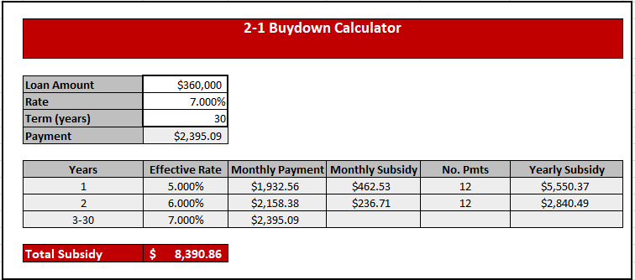
What is the Cost of Buydown?

Slide 22
How Does a Temporary Buydown Work?

Slide 23
Temporary Interest Rate Buydown
Seller Provides Concession to Pay Interest Rate Buydown Cost
Homebuyer Eases into their House Payment & Can Refinance When Rates Drop
Buyer Qualifies at the Note Rate
Pre-Approval
Sales Contact
Ease Affordability
Step 1
Step 2
Step 3
Simplified Version

Slide 24
What Happens Behind the Scenes?

Slide 25
Step 1-
Title Collects Seller Concession at Closing
Lender Funds Escrow Account with Seller Concession & Manages Draws from Account
Step 2-
Step 3-
Lender Pays Payment Difference each Month from the Escrow Account
Step 4-
Mortgage Note Rate is Still the Rate for the Entire Period (i.e. 30 years, 10 Year ARM)

Slide 26
What Types Temporary Buydowns are There?

Slide 27
Types of Interest Rate Buydowns
3-1 Buydown
2-1 Buydown
1-1 Buydown

Slide 28
What Types of Loans Offer Temporary Buydowns?

Slide 29
Loan Types for Temporary Buydown
Lenders have to setup Escrow Account to pay the difference each month so VERY RESTRICTIVE by Lender
Conventional
FHA
VA
USDA

Slide 30
Housing Loans DO NOT Have Temporary Buydown Options

Slide 31
Temporary Interest Rate Buydown

Slide 32
LENDER MUST Structure the SALES CONTRACT Language and the MORTGAGE LOAN Correctly to Avoid Predatory Lending Laws!!!
Language MUST be Added to the Sales Contract for the Seller Paid Temporary Buydown

Slide 33
Seller Concession Options

Slide 34
Option 1 – Price Reduction
Option 2 – Seller Paid Closing Cost
Option 3 – Seller Paid Discount Points
Option 4 – Seller Paid Temporary Buy Down
Option 5 – Seller Paid MI Buyout

Slide 35
Four Mortgage Insurance Options

Slide 36
Borrower Paid Monthly MI (Most Common)
Lender Paid Monthly MI (Higher Rate)
Single Premium MI (Buying Out MI)
Split Premium MI (Combo of BPMI & SPMI)

Slide 37
Seller Paid MI Buyout
Only Available on Conventional Loans
MI Buy Out is Single Premium MI
MI is Based on Risk Based Pricing So Credit Score Affects How Much it Costs to Buyout

Slide 38
Example MI Buyout Great Credit
Purchase Price - $400,000
Down Payment - $40,000 (10%)
Loan Amount - $360,000
Par Rate – 7.0%
Payment - $2,395.09 (P&I)
Credit Score – 760
Monthly MI = $51
Single Premium MI - $2,664

Slide 39
Example MI Buyout Avg. Credit
Purchase Price - $400,000
Down Payment - $40,000 (10%)
Loan Amount - $360,000
Par Rate – 7.0%
Payment - $2,395.09 (P&I)
Credit Score – 680
Monthly MI = $123
Single Premium MI - $6,408

Slide 40
Example MI Buyout Bad Credit
Purchase Price - $400,000
Down Payment - $40,000 (10%)
Loan Amount - $360,000
Par Rate – 7.0%
Payment - $2,395.09 (P&I)
Credit Score – 620
Monthly MI = $252
Single Premium MI - $11,376

Slide 41
CANNOT Get More Seller Concessions Than Allowed By Loan Program

Slide 42
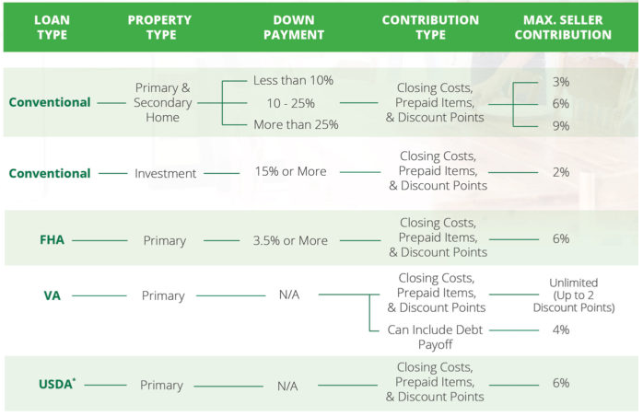

Slide 43
Benefits to Home Seller

Slide 44
Benefit 1-
Seller Credits Help a Home Sell Faster in Shifting Market & Maintain Value of Neighbourhood.
Benefit 2-
Price Reductions are Typically Costlier to a Seller than Seller Credits
Benefit 3-
Innovative “Good Will” to Help a New Homeowner Adjust to Homeownership

Slide 45
Which Option is the Best for the Buyer and the Seller?

Slide 46
Comparing Options
Original Price Option:
Purchase Price - $400,000
Down Payment - $40,000 (10%)
Loan Amount - $360,000
Rate – 7.0%
Payment – 2,395.09 (P&I)
Seller Concession - $0

Slide 47
Seller Agrees to Price Reduction of 10k-15k

Slide 48
Comparing Options to Lower Payment
Dropping Price Option:
Purchase Price - $385,000
Down Payment - $38,500 (10%)
Loan Amount - $346,500
Rate – 7.0%
Payment – $2,305.27 (P&I)
Monthly Savings - $89.82
Seller Concession - $15,000

Slide 49
Comparing Options to Lower Payment
Permanent Buydown Option:
Purchase Price - $400,000
Rate – 6.5%
Payment – 2,275.44
Monthly Savings - $119.65
Seller Concession - $10,800
Temporary Buydown Option:
Purchase Price - $400,000
Rate – 5.0 %
Payment – $1,932.56
Monthly Savings - $462.53
Seller Concession - $8,390.86

Slide 50
Comparing Options to Lower Payment
Seller Drops Home Price:
Purchase Price - $385,000
Rate – 7.0%
Buyer Savings - $89.92
Seller Concession - $15,000
Seller Net - $385,000
Permanent Buydown Option:
Purchase Price - $400,000
Rate – 6.5%
Buyer Savings - $119.65
Seller Concession - $10,800
Seller Net - $389,200
Temporary 2-1 Buydown Option:
Purchase Price - $400,000
Rate – 5.0 %
Buyer Savings - $462.53
Seller Concession - $8,390.86
Seller Net - $391,609.14

Slide 51
Comparing Options to Lower Payment
Temporary 3-1 Buydown Option:
Purchase Price - $400,000
Rate – 4.0 %
Buyer Savings - $676.39
Seller Concession - $16,507.59
Seller Net - $383,492.41

Slide 52
Comparing Options:
Lender and Agent Need to Work Together on a Case by Case Basis to Figure Out which Option is Best for Which Client
MUST Work with a Lender Partner that has the Experience & the Capacity to Offer Each of the Options Discussed and Present to the Seller

Slide 53
Just a Few of Our USPs
Call, Text, & E-mail Every Lead within 4 Business Hours (7 Days a Week)
Chase New Leads for 8 Days Straight Then Make Cold Lead & Chase Once a Month Forever
Weekend Warrior Program and Open 7 Days a Week, Mon – Fri 9 AM till 8:30 PM
Review for Pre-Approval within 24 Hours
Close within 21 Days

Slide 54
John Thomas Team
We Want to Be Your Lender Partner!!!!
We Want to Be Your Partner and Help You
Build Your Business. We are Committed to Your Success!

