Slide 1

Understanding Credit &
The home buying process

Slide 2

agenda
01
05
History of credit
Applying for
credit
02
Credit Scoring model
06
Credit &
Your Mortgage
Consumer score
Vs Mortgage Score
03
04
Reading a
Credit report

Slide 3

1
History of
Credit

Slide 4


History of credit scoring
fico
FCRA
ecoa
1956 – FICO Creates First Credit Scoring Model
1970 – Fair Credit Reporting Act – Updated in 2003
1974 - Equal Credit Opportunity Act – No Discrimination

Slide 5

credit laws - FCRA
Credit Laws Provide the Following:
Right to See Credit File (Report)
Right to Receive Score from Lender
Right to Dispute Information
Information Must be Kept Private
Right to Opt Out of Information being Sold / Shared

Slide 6
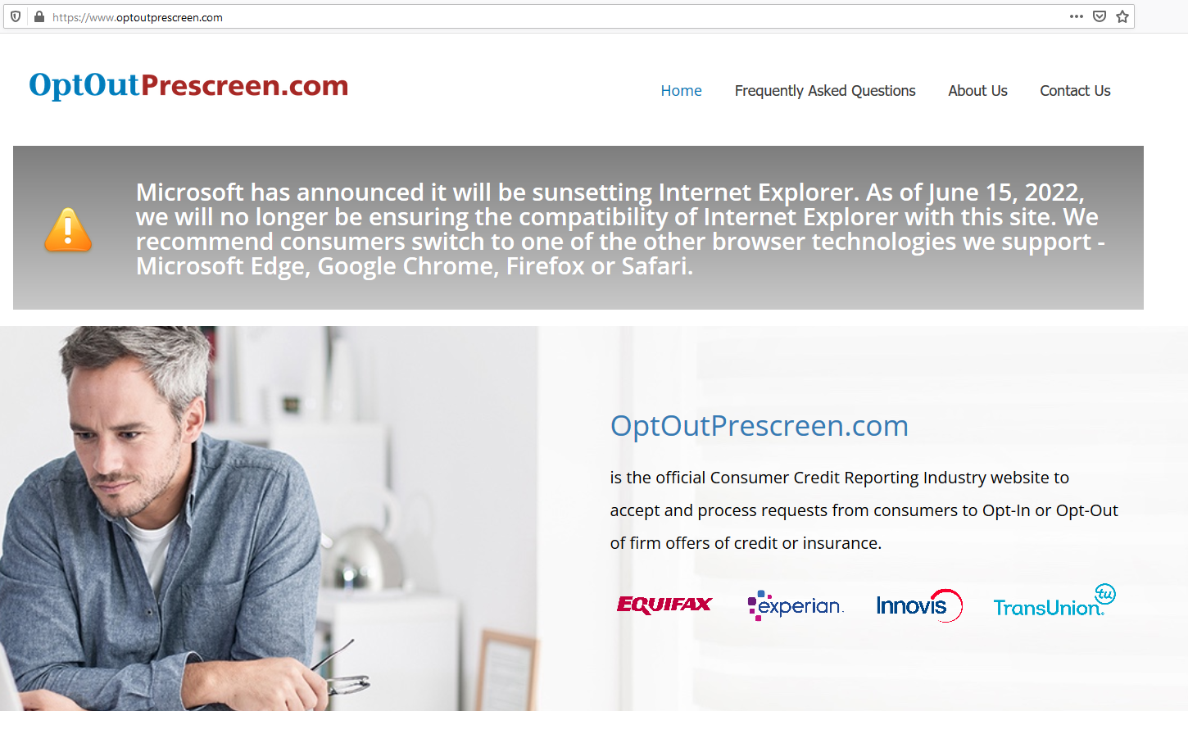
Opt Out Now!
Stop Your Info
From being shared

Slide 7
What is a credit score?

Slide 8

Credit Score
A three Digit Number used by Lenders to Evaluate the Risk associated with Lending Money.
Mortgage Lenders Use the FICO Scoring Model
Lower Score Equals Higher Risk of Default

Slide 9
What is a credit report?

Slide 10
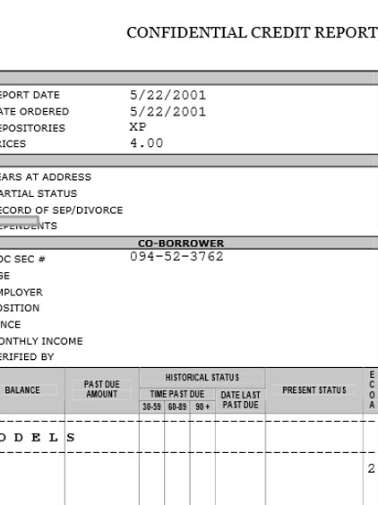
Credit report
A Detailed Breakdown of your Credit History prepared by a Credit Bureau
Reports include:
Personal Information
Details of Credit Lines
Public Records
Employment & Address History

Slide 11
What is a credit bureau?

Slide 12

Credit bureaus
A Credit Bureau, also know as a Credit Reporting Agency (CRA), Collects and Researches Individual Credit Information into a Credit Report.
Then the CRA Assigns a Credit Score Based on Their Credit Scoring Model

Slide 13
The Credit Bureaus
Also known as Credit Reporting Agencies or CRAs
Three independent companies from one another
A creditor may choose which CRAs, if any, to report their debts to. Except in the case of a mortgage account which is required to be reported
Because each creditor can choose which bureaus to report to, the credit scores will vary between bureaus due to different information being reported AND slightly different credit scoring algorithms being used

Slide 14

2
Credit Scoring
Model

Slide 15
What credit scoring model
Do mortgage lenders use?

Slide 16

Mortgage Credit Scores
Mortgage Lenders ONLY Use FICO Scoring Models
Equifax FICO Scoring Model = Beacon 5.0
Experian FICO Scoring Model = FICO-II
TransUnion FICO Scoring Model = FICO Classic 04

Slide 17
Who Supplies Information
To the credit bureaus?

Slide 18

Creditor / Lender
The Creditor or Lender supplies the Credit Bureaus (CRAs) with information typically on a monthly basis
Creditor Pays a Fee to Report Each Tradeline So They are the CRAs True Clients NOT the Consumer

Slide 19
How Information Gets to Your Credit Report
Credit Vendor

Slide 20
What is a credit vendor?

Slide 21

Credit Vendors
A Credit Vendor is a company who buys information from the 3 different credit bureaus and then compiles and sells the information to Banks and Lenders in the form of a Tri-Merge Credit Report.
A Credit Vendor Can Also Provide services like “CreditExpert” and “Rapid Re-Scores”
Examples: CoreLogic Credco, Kroll Factual Data, Cisco, etc

Slide 22
What is the fico
credit scoring model?

Slide 23
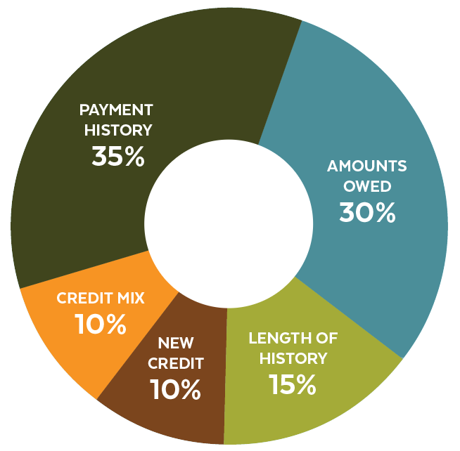
FICO Credit Scores
To generate a score, the CRA applies a mathematical algorithm, or “scoring model,” to the information in the Credit Report being used. Not All Items are Weighted Equally as Can be Seen from the Pie Chart

Slide 24
Primary Factors That Affect Credit Scores
  PAYMENT HISTORY: 35%
    LATE PAYMENTS
    ITEMS IN COLLECTIONS
    LENDER'S #1 PRIORITY- PAST RECORD OF REPAYMENT
  CREDIT UTILIZATION: 30%
    BALANCES
    AVAILABLE CREDIT
    PERCENTAGE OF EXISITNG CREDIT USAGE
    NEGATIVE PUBLIC INFO

Slide 25
Secondary Factors That Affect Credit Scores
  LENGTH OF HISTORY: 15%
    HOW LONG ACCOUNTS HAVE BEEN OPEN
    WHEN THE ACCOUNTS WERE LAST USED
  NEW CREDIT: 10%
    TAKING OUT NEW DEBT
    NEW ACCOUNT & INQUIRES
  CREDIT MIX: 10%
    SPECIFIC TYPES: REVOLVING & INSTALLMENT

Slide 26

3
Consumer score
Vs Mortgage score

Slide 27
What is a consumer score?

Slide 28

consumer Credit score
Consumer Credit Scoring Model is the Vantage Credit Score.
There are 4 Different Vantage Scoring Models:
Vantage 1.0
Vantage 2.0
Vantage 3.0
Vantage 4.0

Slide 29
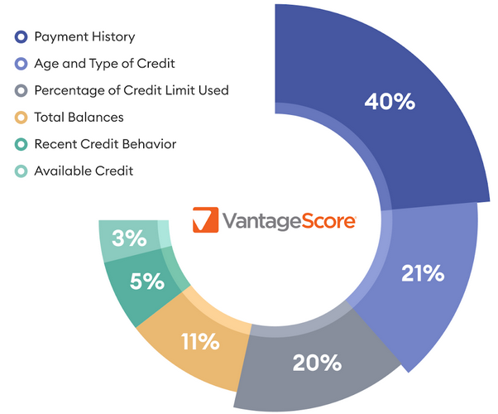
Vantage credit score
Most Credit Monitoring Services and Credit Karma Use the Vantage 3.0
The Scores Range from 300-850 to Mimic FICO BUT Not Same Scoring Model!

Slide 30
fico vs vantage

Slide 31

4
Reading a
Credit report

Slide 32

Personal Information
Name
Address(es)
Date of Birth
Social Security Number
Employer
Aliases
All can be found either at the very front of the credit report OR towards the back (right after the account information stops)

Slide 33
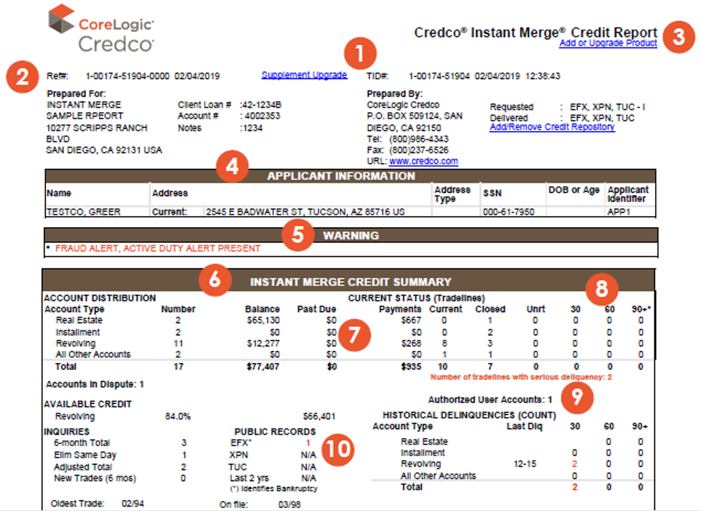
SUMMARY

Slide 34
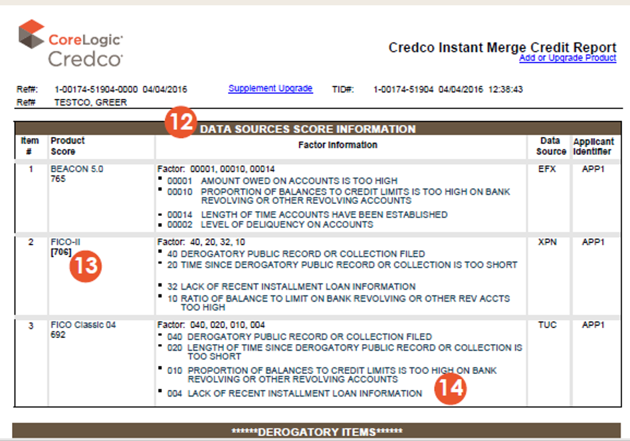
Credit Scores
Middle Score
This is the true middle score, not the average. Meaning, throw out the high score and throw out the low score. The Mid Score is used for the approval decision.

Slide 35
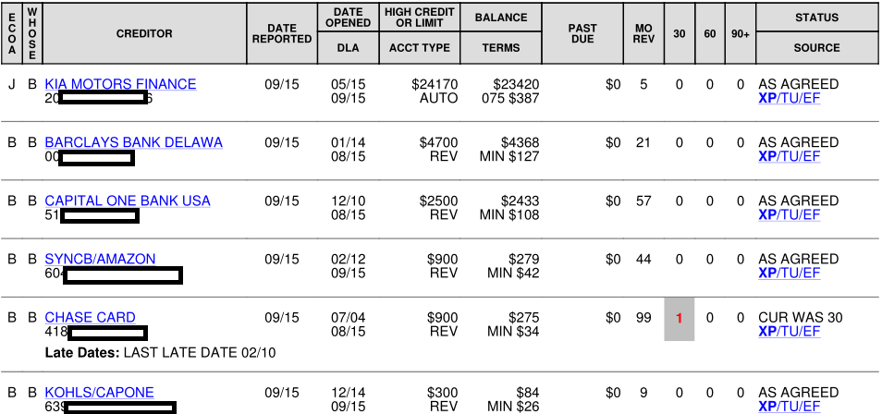
Reading a Tradeline
They give you a key, you just have to know the terminology!

Slide 36
ECOA Indicates Responsibility

Slide 37

ECOA Letter Code
B
= Borrower
ECOA Letter
Code
C
= Co-Borrower
J
= Joint
A
= Authorized User
1
Borrower =
ECOA Numerical Code
Co-Borrower =
8
2
Joint =

Slide 38
Creditor is Company Reporting

Slide 39
Date Last Reported
Date Last Reported indicates the last time the Creditor Updated Their Information with the CRA

Slide 40
Date Opened
Date Opened is when that particular creditor took ownership of the debt.

Slide 41
DLA or Date of Last Activity
DLA or Date of Last Activity indicates the last time a Payment was Made on the Account.

Slide 42
High Credit or Limit
High Credit or Limit indicates either the total amount of credit that the client is being extended OR the highest dollar amount has ever been charged on that account

Slide 43
Account Type
Account Type indicates what the format of the loan/line of credit is such as Instalment, Revolving, Mortgage, etc.

Slide 44
Payment Terms & History
Balance indicates how much was owed at last report by the Creditor
Terms shows the payment amount and the length of the contract
Past Due will show if the account is currently behind on payments
30,60,90 will show how far delinquent the account has gone in the past

Slide 45
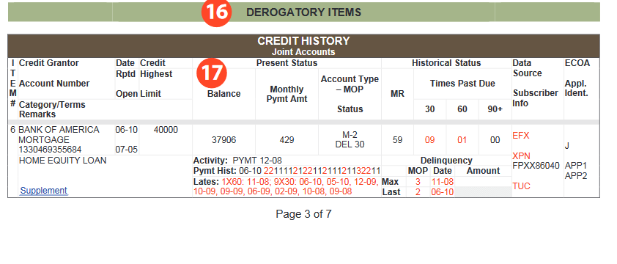
Manner of Payment (MOP)
Manner of Payment (MOP) Ratings determine the current status of the account.

Slide 46

There will be
a letter that indicates
the Account Type
MOP Coding
R
= Revolving
I
= Installment
O
= Open
M
= Mortgage
There will be a Letter and Number Combination for MOP Code such as M-1

Slide 47
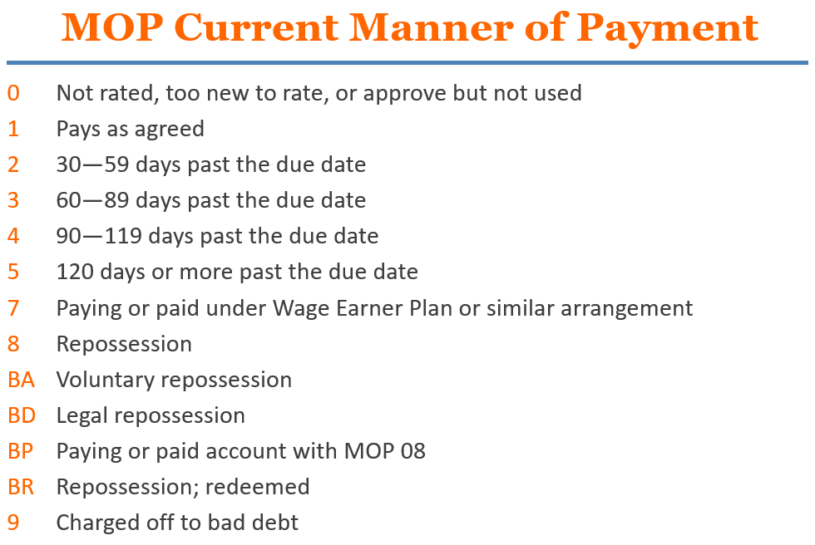
MOP Key

Slide 48
What is a collection?

Slide 49
Credit collection
A Collection is filed with the CRA when a debt goes delinquent and no repayment has been agreed upon in place of the original agreement.
A Collection Should be Reported as a 9 MOP Rating
A Collection is filed by a 3rd Party. The Original Lender has Sold the debt to a 3rd Party Agency to Collect the Debt from the Borrower.

Slide 50
What is a Charge off?

Slide 51
Credit Charge off
Charge Off DOES NOT mean the Creditor has “Given Up” or “Written Off” the Debt for good.
It is debt that has gone to collection/delinquent status but is still being collected by the ORIGINAL CREDITOR.

Slide 52
What are
statuTe of limitations?

Slide 53

Statute of limitations
Statute of limitations (SOL) on Debt puts a Time Limit on the amount of time a Creditor can collect on the Debt.
SOL Begins the Date an account becomes Delinquent. Time Frame is Based on State Law.

Slide 54

5
Applying For Credit

Slide 55
How Long Does information
Stay on credit report?

Slide 56

Credit reporting time frames
Good Accounts Stay for 10 Years from Date of Last Activity.
Bad Accounts Generally Stay on for 7 Years, except:
Ch 7 BK = 10 years from File Date
Ch 13 BK = 7 years from File Date
Judgments = No Longer Appear
Paid & Unpaid Tax Liens = no longer appear
Hard Inquiries Stay for 2 years

Slide 57
How does shopping for a
mortgage affect my credit?

Slide 58

Shopping for a mortgage lender
Consumers Have 30 Days To Shop for a Mortgage Lender and Counts as Only One Inquiry at End of the 45 Days.
How Many Lenders Can Check It? UNLIMITED!!!
SOURCE – Consumer Financial Protection Bureau (CFPB) & FICO (CFPB Says 45 Days but FICO says 30 Days)

Slide 59
Does a Mortgage Credit
Check Drop My Score?

Slide 60

NO!
Not for 45 days!

Slide 61

After 45 days
Only Lose
0-5 Points

Slide 62

6
Credit and Your mortgage

Slide 63
What does lender look
for on credit report?

Slide 64

Lender is Looking for Your Willingness to Repay debts

Slide 65

Your credit score is a measure of how well you re-pay your debts

Slide 66
How Does credit affect rateS?

Slide 67

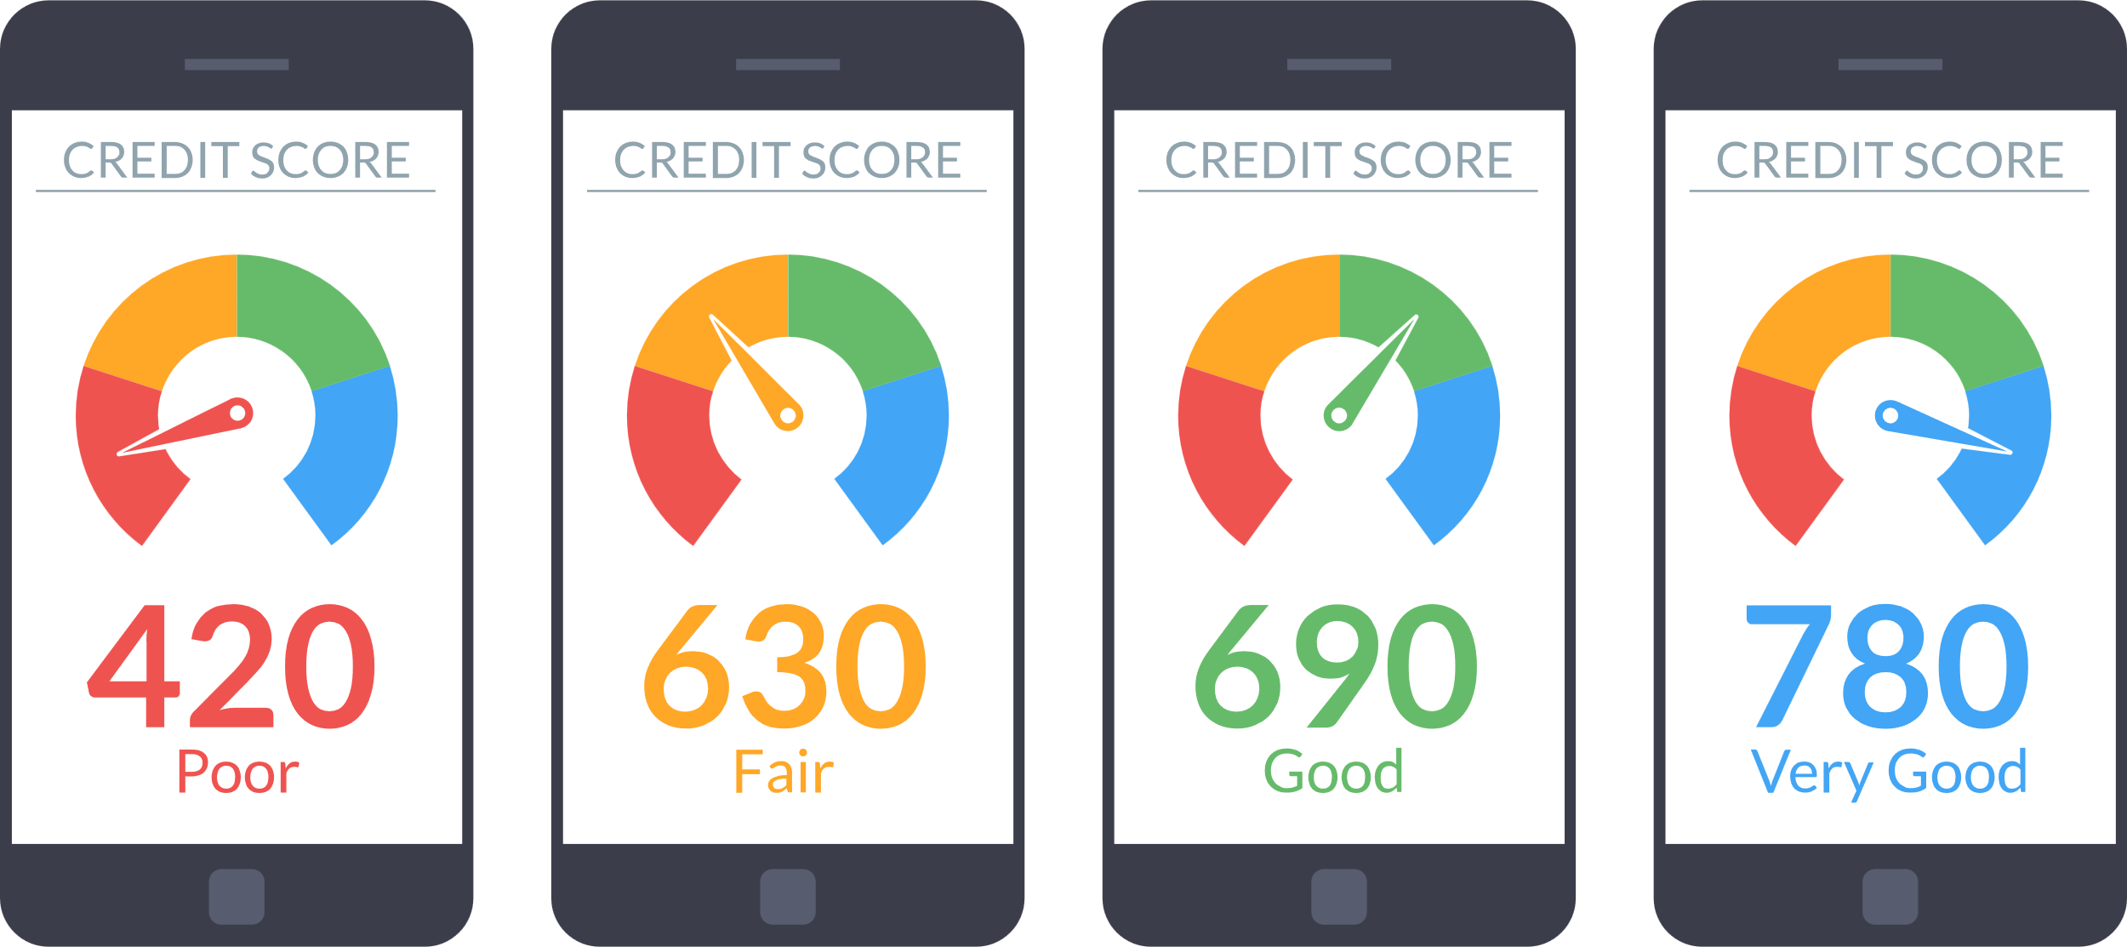
Interest Rate is Reflection of Risk
The Lower the Credit Score the Higher the Interest Rate
The Higher the Credit Score the Lower the Interest Rate

Slide 68

Minimum Score for Mortgage?
Conventional Loan – 620 Credit Score
FHA Loan with 3.5% Down – 580 Credit Score
FHA Loan with 10% Down – 500 Credit Score
VA Loan – 580 Credit Score
USDA Loan – 620 Credit Score

Slide 69
What are the wait periods
for derogatory credit?

Slide 70

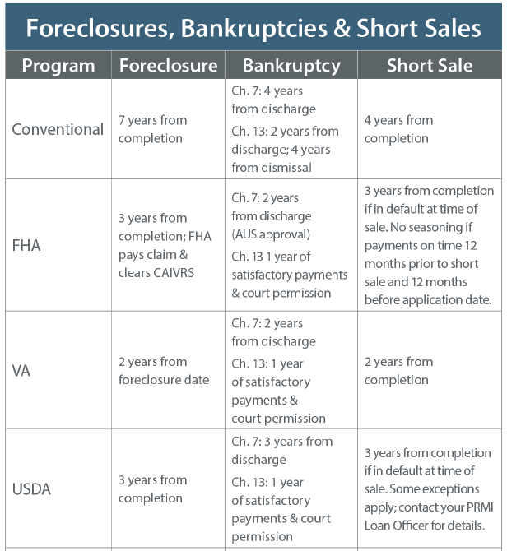

Slide 71
How do you improve
Your credit score?

Slide 72
Common Credit Score Myths
Carrying a credit card balance will improve your score.
There is only one credit score.
Closing your old credit cards can boost your score.
Co-signing on a loan won't affect your credit.
Paying off collections and other debt removes it from your credit report.
Paying off your credit card each month hurts your score.
Notes:
Common credit score myths
#1: Carrying a credit card balance will improve your score
Nearly 60% of consumers believe this myth, according to a recent survey by US New & World Report. One of the main factors in determining your credit score is your credit utilization ratio, or the percentage of your available credit that you’re using at any given time. The lower the number, the better — but aim to keep it under 30%.
#2: There’s only one credit score
While FICO is the most popular score provider, different types of lenders use different versions of the score. Plus, a growing number of lenders work with FICO competitors, such as VantageScore.
“There are many, many different credit scores out there, and the score that you just saw might not be the same one lenders see when they’re examining your creditworthiness.
#3: Closing your old credit cards can boost your score
The length of your credit history is another factor that goes into your credit score. So, keeping your oldest cards open, and occasionally using them (and paying them off) helps rather than hurts your score. Lenders look at the age of your credit (how long you stay with lenders). Closing an account lessens the average age of the accounts you have open.
#4: Co-signing on a loan won't affect your credit
From a credit agency's point of view, co-signing a loan is the same thing as taking out a loan on your own. That loan balance will impact your credit utilization ratio, and late payments will hurt your credit score.
#5: Paying off a collections account and other debt removes it from your credit report
Unfortunately, paying off an overdue debt doesn’t remove it from your credit report or lower the impact of the late payment. Typically, these activities can stay on your report for up to seven years. The good news is that the impact of a negative item does lessen over time, especially if you’ve logged positive credit activities since then.
#6: Paying off your credit cards each month hurts your score
Paying off your credit card balance each billing period can improve your score and shows lenders that you're a responsible borrower. It’s one of the best ways to boost your creditworthiness and lower your credit utilization rate

Slide 73

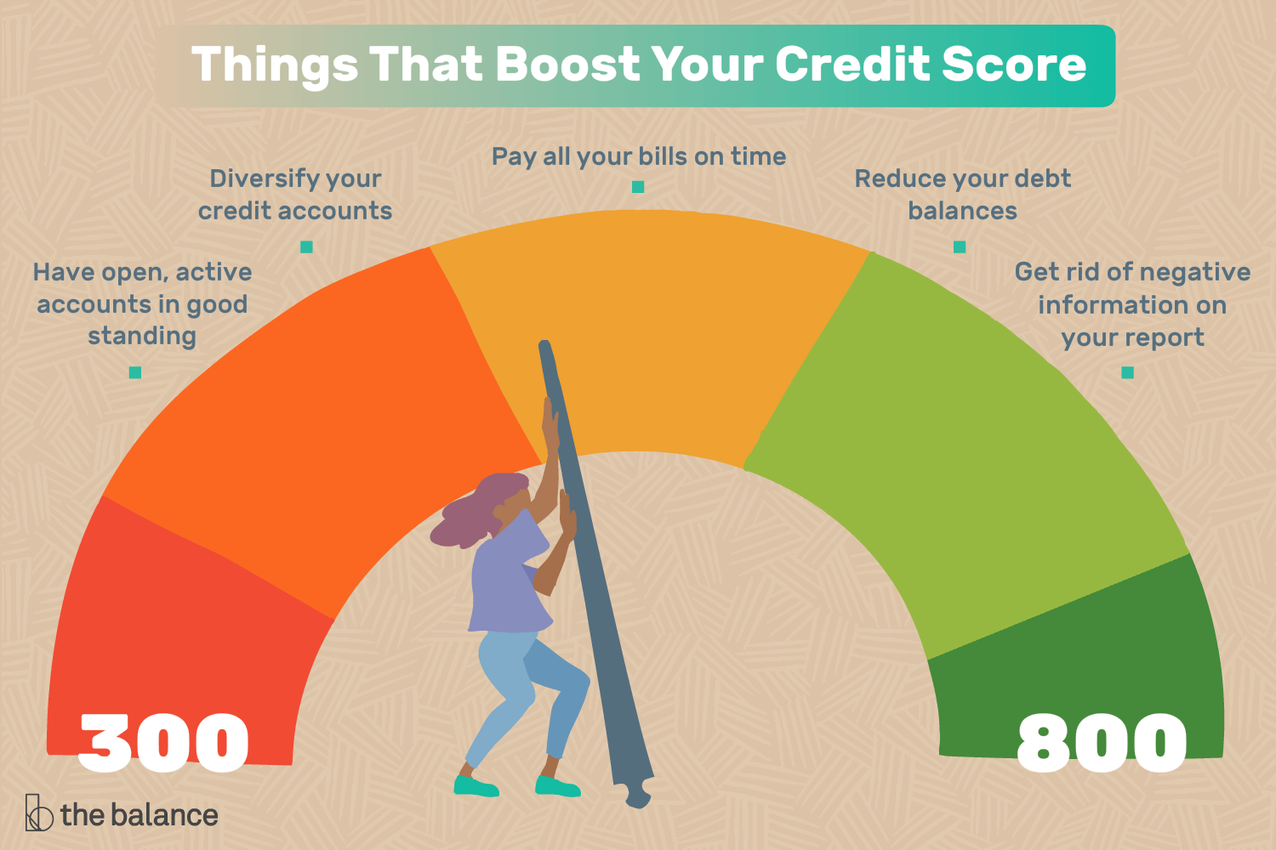







Leave old
accounts open
Only apply for
credit you need
Keep your credit
utilization rate low
Be patient
Pay your bills
on time
Monitor your credit
Notes:
Ways to Improve your credit Scores
Interest rates on all kinds of products — from personal and student loans to mortgages and credit cards — have increased significantly since January, making it more costly for people to borrow money. When you apply for a new line of credit, a high credit score can help you qualify for a low interest rate. Good credit also makes it easier to refinance your debt, which can lower your monthly payments and free up money for other purposes.
Improving a credit score takes time, however. So if your score needs some work, the sooner you start working on it the better off you'll be. Here's how to start…
1. Pay your bills on time
According to Experian, payment history is the most influential factor for both your FICO and VantageScore. From a lender’s perspective, an established history of timely payments is a good indicator you’ll handle future debts responsibly, too.
You want to avoid things like late payments, defaults, repossessions, foreclosures, and third party collections.And filing bankruptcy is a horrible idea. Anything that would indicate non-performance of a liability is going to harm your credit score.
2. Keep your credit utilization rate low
Weigh your balances relative to your credit limit to ensure you’re not using too much available credit, a practice that can indicate risk.
Trying to maintain a utilization rate of 10%. The higher that ratio, the fewer points you’re going to earn in that category and your scores are absolutely going to suffer. In fact, people who have the highest average FICO scores have a utilization of 7%.
The date your credit card provider reports to the credit bureaus may also impact your utilization rate.
FICO’s scoring systems don’t differentiate between those who pay in full each month and those who carry a balance. Your utilization rate at the time your issuer reports is what's used for your score.
If you struggle with high balances and mounting interest payments on your cards, consider consolidating with a 0% introductory rate balance transfer credit card, but make sure you know when the rate will increase and by how much.
3. Leave old accounts open
Once you finally get rid of student debt or pay off your auto loan, you may be impatient to get any trace of it wiped from your report.
But as long as your payments were timely and complete, those debt records may actually help your credit score. The same is true for your credit card accounts.
“An account that’s paid in full is a good thing; however, closing an account isn’t something that consumers should automatically do in the hopes that it will positively impact their credit score. Having an account with a long history and solid track record of paying bills on time, every time, are the types of responsible habits lenders and creditors look for.
Closing a credit card account can actually lower your credit score, as you will now have a lower maximum credit limit. If you’re still carrying balances on other cards or loans, your utilization ratio will go up. You’re better off keeping the card with a $0 balance.
4. Only apply for credit you need
Every time you apply for a new line of credit, a hard inquiry is pulled on your report. This type of inquiry lowers your score temporarily. Applying just to see if you get approved or because you received a pre-qualified offer of credit is not a good idea.
If it’s a single hard credit pull, the drop will be slight. However, a string of hard inquiries could signal to lenders that you are taking on too much debt. The effects of a hard credit pull on your score, according to a representative of TransUnion, can last up to 12 months.
If you do need to apply for new credit, research your likelihood of approval to ensure you’re a good candidate before applying. If possible, get a pre-approval or pre-qualification, as in many instances these result in a soft rather than hard credit pull. Soft pulls don’t affect your credit score You don’t want to risk lowering your score for a denied application.
When you shop for a mortgage loan, you can keep hard inquiries to a minimum by making rate comparisons within a short time period. Applications for the same type of loan within a designated time frame will only appear as a single hard inquiry. According to FICO, this span can vary from 14 to 30 days.
5. Be patient
You won’t drastically improve your credit score overnight. The best way to achieve an excellent score is to develop good long-term credit habits.
Two influential factors that go into your score are the average age of information and the oldest account on your report.
It takes a really, really long time to improve a bad score and it takes a really short amount of time to trash a good score.
Establish good habits, like paying your balances on time, keeping a low utilization rate, and applying for credit only when you need it, and you should see those practices reflected in your score over time.
6. Monitor your credit
When you view your own credit, a soft inquiry is pulled, which doesn’t affect your credit the way hard inquiries do.
Monitoring your score’s fluctuations every few months can help you understand how well you’re managing your credit and whether you should make any changes. However, you shouldn’t base any financial decision you make solely on your credit score.

Slide 74

Action Steps to Improve Credit
Pay Credit Card Balances Down
Pay Any Past Due Accounts ASAP
Don’t Close Credit Accounts – Will Drop Score
Pay Bills On Time – 30 Day Late Lose 100 Pts
Add Revolving Charge Account
Increase Credit Limits

Slide 75
Tools to build your credit

Slide 76
secured
Credit card
Obtain a Secured
Credit Card
To Build Credit
www.SecuredCreditNow.com

Slide 77
Do you need
credit Repair help?

Slide 78


Thank You for Your Time
We Want to Be Your Lender Partner!!!!
We Want to Be Your Partner and Help You Build Your Business. We are Committed to Your Success!

