Slide 1


The VA 1% Rule &
How to Deal with it

Slide 2
Why Is this Important?
We Want:
To consistently adhere to VA rules, as Professionals.
To help prevent VA offers from being dismissed because of misconceptions & misinformation.
To avoid having our hard-earned compensation cut because of a technicality.
Smooth transactions | Escrows, with no surprises.

Slide 3

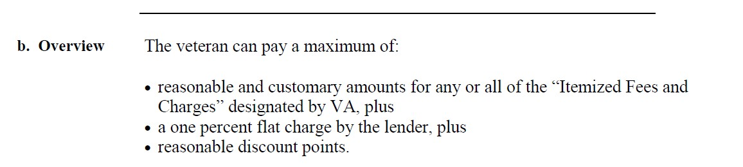
Where do We Begin?
VA Lender’s Handbook Chapter 8

Slide 4
What are Itemized Fees & Charges designated by VA?
Appraisal
Recording fee
Credit report
Prepaid items
Hazard insurance
Flood cert
Title insurance
MERS
Funding fee

Slide 5
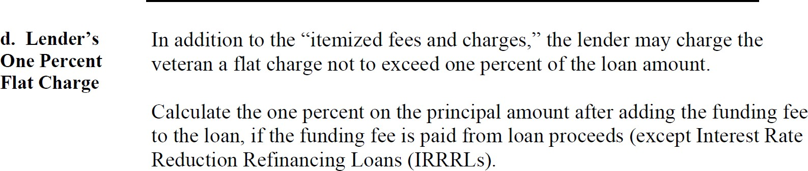
Lender 1% Origination fee charge
The lender’s flat charge is intended to cover all of the lender’s costs and services which are not reimbursable as “itemized fees and charges.”
Notice they call them Lender’s costs and services…

Slide 6
Items that cannot be charged to the veteran as “itemized fees and charges
We call these Non Allowables. Instead, the lender must cover any cost of these items out of its flat fee:
Example: $300,000 VA loan ; 1% Origination fee= $3,000. If settlement fee $700 then deducted from $3000 origination fee. Can you see a problem with this?
The following list provides examples of items that cannot be charged to the veteran as “itemized fees and charges.” Instead, the lender must cover any cost of these items out of its flat fee:
    Lender’s appraisals
    Lender’s inspections, except in construction loan cases
    Loan closing or settlement fees
    Document preparation fees
    Preparing loan papers or conveyancing fees
    Attorney’s services other than for title work
    Photographs
    Interest rate lock-in fees
    Postage and other mailing charges, stationery, telephone calls, and other overhead
    Amortization schedules, pass books, and membership or entrance fees
    Escrow fees or charges
    Notary fees
    Commitment fees or marketing fees of any secondary purchaser of the mortgage and preparation
    and recording of assignment of mortgage to such purchaser
    Trustee’s fees or charges
    Loan application or processing fees
    Fees for preparation of truth-in-lending disclosure statement
    Fees charged by loan brokers, finders or other third parties whether affiliated with the lender or not, and
    Tax service fees.
Notes:
We call these Non Allowables. Instead, the lender must cover any cost of these items out of its flat fee:
Example: $300,000 VA loan ; 1% Origination fee= $3,000. If settlement fee $700 then deducted from $3000 origination fee. Can you see a problem with this?
The following list provides examples of items that cannot be charged to the veteran as “itemized fees and charges.” Instead, the lender must cover any cost of these items out of its flat fee:
lender’s appraisals
lender’s inspections, except in construction loan cases
loan closing or settlement fees
document preparation fees
preparing loan papers or conveyancing fees
attorney’s services other than for title work
photographs
interest rate lock-in fees
postage and other mailing charges, stationery, telephone calls, and other overhead
amortization schedules, pass books, and membership or entrance fees
escrow fees or charges
notary fees
commitment fees or marketing fees of any secondary purchaser of the mortgage and preparation and recording of assignment of mortgage to such purchaser
trustee’s fees or charges
loan application or processing fees
fees for preparation of truth-in-lending disclosure statement
fees charged by loan brokers, finders or other third parties whether affiliated with the lender or not, and
tax service fees.

Slide 7
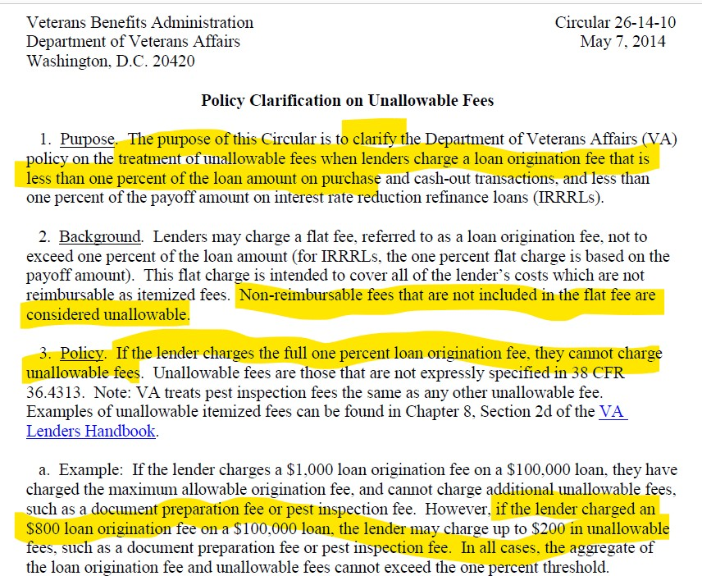
2014 Clarification by VA

Slide 8
Summary
Let’s Preview Calculation Worksheet
IF YOU charge an Origination fee of 1% then the Veteran cannot pay any non Allowable fees.
Who can pay them?
3rd party- such as a Gift from family
Lender- out of their 1% origination fee
Seller
Realtor
What about lender credit via premium pricing?
If you charge 1% Origination fee and then charge the Veteran non allowable fees and raise the rate to get Lender credit to cover those, VA considers that prohibited. Why? Because by means of the raised rate, Veteran is paying for the cost of it. This is grey.

Slide 9
Play on Words
An Unallowable fee is only an Unallowable for Veteran to Pay if the 1% Origination fee was charged.
There are Fees that can ALWAYS be charged & paid by Veteran– itemized/Reimbursable
There are Fees that can be charged and paid by Veteran under certain circumstances.
There are Fees that can NEVER be charged to the Veteran. What are they?

Slide 10
Common Issue surrounding this Topic
Example of misconception: ROCKET definition incorrect https://www.rocketmortgage.com/learn/va-non-allowable-fees
Unsuspecting Buyers Agent sends offer telling the Listing Agent, the Seller has to pay the Non Allowables because the Veteran cannot pay them. Listing agent tells seller, seller says no and selects CONV offer that’s not forcing seller to pay any fees. Who just lost??

Slide 11
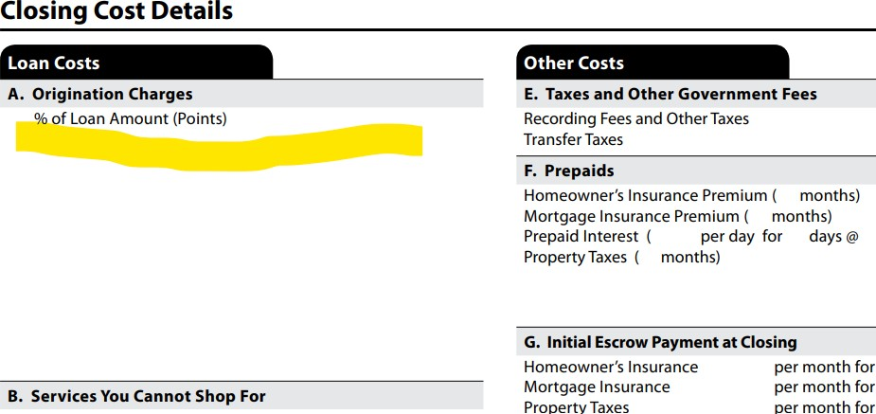
Possible Solution
Why selecting Borrower Paid 1% ?
Two Choices When Selecting Borrower Paid 1% VA Loan:
Brokered
Correspondent
If Brokered : then Lender calls it Broker fee or origination fee on LE:

Slide 12
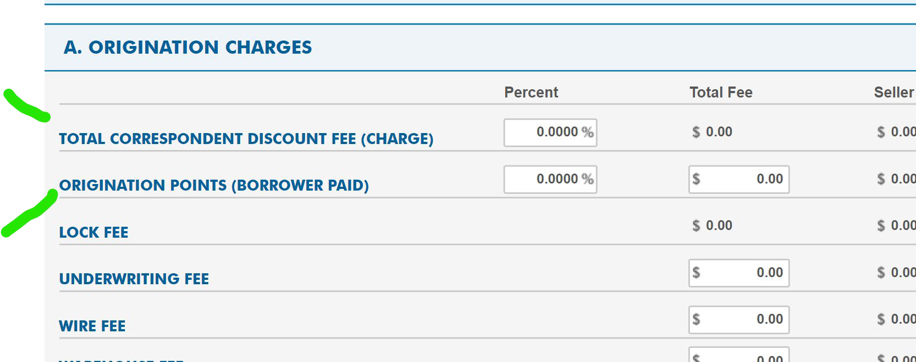
Possible Solution
If Correspondent :
Discount Points are paid for the rate chosen.
VA deems upto 2% Discount Points as customary and NOT an Origination Fee/Charge.

Slide 13
CALVET’s Solution
CALVET loans always have a 1% Borrower paid charge. So Non Allowables are always an issue if there’s no Seller credit. CALVET moves fees around to solve this problem:
Instead of Seller paying owners Title Policy & Transfer Taxes - They have Veteran pay it, and have Seller agree to pay non allowables.
CALVET loans don’t require Lenders Title insurance – so Veteran has some funds left to pay.

