Slide 1
Va home loan 101

Slide 2
Types of VA LOANs
Purchase loan
Looking to buy a home? Then this one’s for you!
Interest Rate Reduction Refinance Loan (IRRRL)
Have an existing VA-backed home loan? See if you're eligible for a VA-backed IRRRL to help reduce your monthly payments or make them more stable.
Cash-out refinance loan
Want to take cash out of your home equity to pay off debt, pay for school, or take care of other needs?

Slide 3
Benefits of the VA loan (WIIFM)
ZERO MONEY DOWN | NO MORTGAGE INSURANCE | LOWER INTEREST RATES
Ability to buy a house with ZERO down (No Down Payment required, though Closing Costs apply) | No Mortgage Insurance; An added monthly cost which is factored into Civilian mortgage loans where less than 20% is put down. Can be as high as $600 or more! | Lower interest rates than ALL other loans (Less interest paid means more $$$ in your pocket) VA Loans are typically .25% lower then Conventional ones

Slide 4
Who qualifies for a va loan
If you’re on active duty, or called up for Active-Duty service, you may be on the fast track to earning your home loan benefits. (Requirements vary for periods.) Here is a summary of requirements to qualify:
List 90 continuous days for active duty servicemembers
90 days of active service for current Guard and Reserve servicemembers
6 SATISFACTORY years in the reserves (50 points per year) if you haven’t deployed or been activated

Slide 5
HOW TO QUALIFY FOR A VA LOAN USING YOUR COE (CERTIFICATE OF ELIGILIBITY)
Apply for your VA COE online via the Department of Veterans Affairs e-Benefits portal.
Use VA Form 26-1880 to apply via by mail. Mail in VA Form 26-1880 to: PO Box 100023
***Veterans who have found an approved VA lender can ask their loan officer to request their COE electronically***

Slide 6
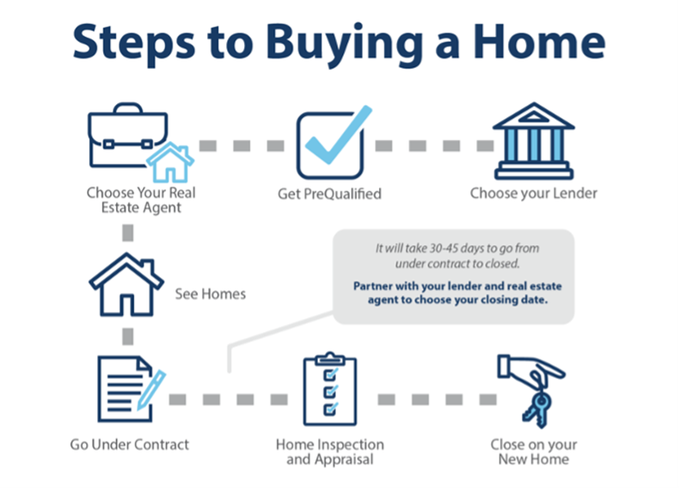
HOW TO USE YOUR VA HOME LOAN TO BUY A HOUSE
Choose a Lender (get pre-approved)
Find an Agent
Go Searching for a Home
Find an Attorney to go Under Contract With
Home inspection and Appraisal Process
Title and Finishing up with Mortgage Docs
Closing on your home!

Slide 7
VA LOAN MYTHS!
VA Loans can be used MORE than once!
VA Loans can be used on ANY residential property UP TO 4 units
VA Loans do NOT have loan limits. You can get a loan for $5 Mil while putting only 0% down! (Assuming of course you make enough to qualify)
VA Loans do NOT come from the VA. They are only Guaranteed by them, but the VA has NOTHING to do with actually doing them (Thank God!)
You can have 2 VA Loans at once (Split Entitlement)

Slide 8
Questions? Comments?

Slide 9
For Reference
7 Jul 2021 Military.com. “10 Things to Know about VA Loan Eligibility.” Military.com, July 7, 2021. https://www.military.com/money/va-loans/va-loan-eligibility-10-things-to-know.html.
“Interest Rate Reduction Refinance Loan.” Veterans Affairs. Accessed July 17, 2022. https://www.va.gov/housing-assistance/home-loans/loan-types/interest-rate-reduction-loan/.
Odion-Esene, Brai. “What Are the VA Loan Requirements?” Forbes. Forbes Magazine, July 5, 2022. https://www.forbes.com/advisor/mortgages/va-loan-requirements/.
Savchenko, Alena. “10 Simple Steps to Purchase a Home.” Pennymac. PennyMac Loan Services, April 2, 2020. https://www.pennymac.com/blog/10-steps-home-purchase.
“Where to Find Your VA Certificate of Eligibility (COE).” Home.com, September 22, 2021. https://home.com/va-certificate-of-eligibility-coe/.

